Slide 1

KARPAGAM INSTITUTE OF TECHNOLOGY, COIMBATORE. (Approved by AICTE and Affiliated to Anna University) ( Accredited by NBA(CSE,IT,ECE)
NAAN MUDHALVAN
TEAM NO – CD1_1
ASTROLOGY WEBSITE
DHANA LAKSHMI S | 721220104007
KALPANA SRI R | 721220104014
KEERTHANA S | 721220104016
KIRUBA E | 721220104018

Slide 2
PROBLEM STATEMENT
Users visit the website seeking valuable information and guidance related to their zodiac signs, but the current content fails to deliver personalized and insightful content that resonates with their individual characteristics. The existing zodiac sign insights are generic, repetitive, and lack depth, leading to declining user retention and trust.
The website provides the same generic zodiac sign insights to all users, regardless of their birthdate or other personal details. This one-size-fits-all approach fails to resonate with users, as they seek content that is tailored to their unique personality traits and life circumstances.

Slide 3
PROPOSED SYSTEM
Develop a system that can collect user birthdate information and use it to generate highly personalized zodiac sign insights for each user. These insights should reflect the unique traits, challenges, and opportunities associated with their zodiac sign.
Implement a fact-checking and validation process to ensure the accuracy of the zodiac sign insights. Validate the inaccuracies in the existing content and maintain a high standard of reliability.
Develop features and tools that encourage users to actively engage with the zodiac sign insights section. This may include interactive quizzes, forums, or daily horoscopes.
Implement machine learning algorithms to analyze user birthdate data and generate personalized zodiac sign insights. The system should take into account astrological principles and user behavior patterns to deliver highly relevant content.

Slide 4
TECHNOLOGY
Server-side scripting – PHP, Javascript
Storage – My SQL Database
Planetary position & Compatibility Calculation – Astrology APIs Astroseek
Scheduling Tools – Content Calender for automation
SEO, Interactive tools for quizzes.
Content Management System – Word Press or Drupal

Slide 5
BENEFITS
Users can receive personalized astrology insights and horoscopes based on their birthdates, enhancing the relevance and value of the content. The website can serve as an educational platform where users can learn more about astrology, zodiac signs, and related topics.
Having a one-stop platform for astrology-related information saves users time and effort in seeking out daily horoscopes and insights from multiple sources.
As the website grows in popularity, it can be scaled to accommodate increased traffic and user demands, ensuring a consistent user experience.
Collecting user data, including birthdates and preferences, can provide valuable insights into user demographics and interests, enabling targeted marketing and content creation.

Slide 6
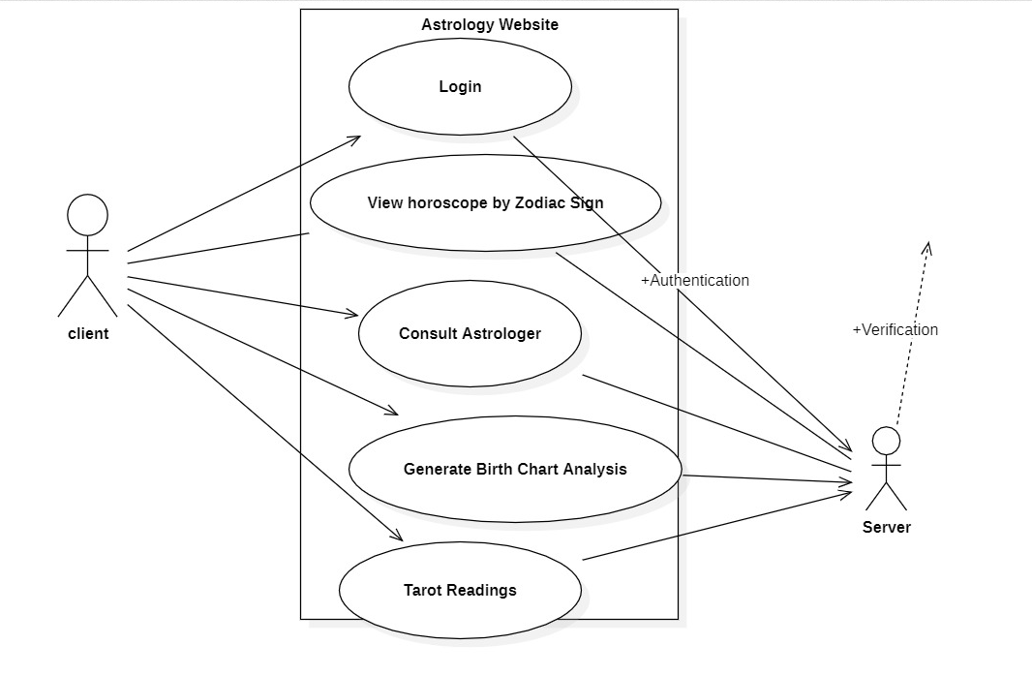
USECASE DIAGRAM

